Slide 3
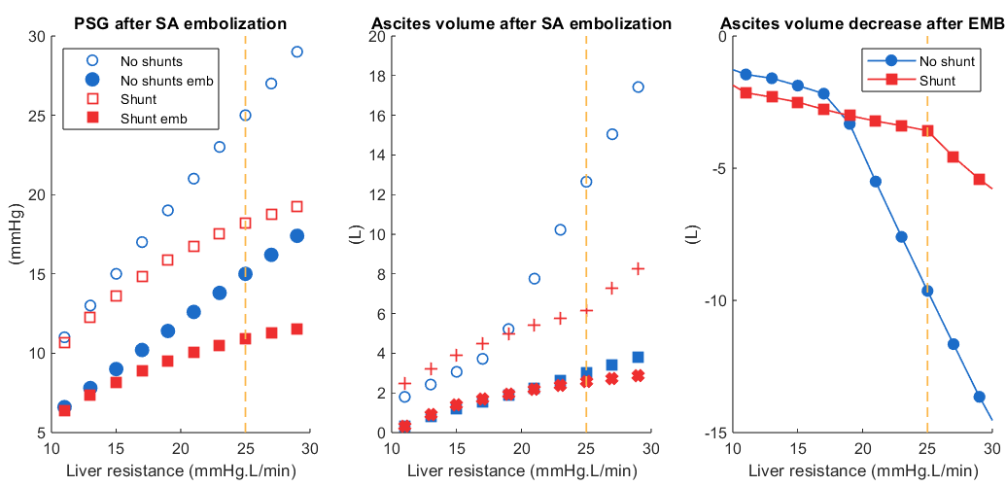
Inflow drops by 40%
A
B
C

Slide 4
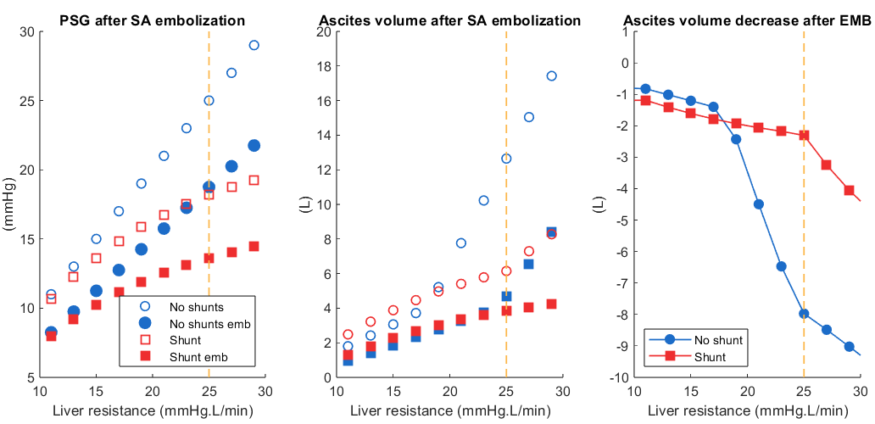
Inflow drops by 25%
A
B
C

